Slide 1
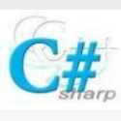


C#

Slide 2

Overview
Introduction to C#
What is C Sharp ?
Working of C Sharp
Features of C Sharp
Basic Programming Structure
Namespaces
Data Types
Variables
Expressions and Operators
Control Statement- Select
Control Statement- Loop
Array , Enums
Introduction to Class

Slide 3
Introduction
Microsoft developed C#.
Anders Hejlsberg, the principal architect of C#.
C# will be familiar to those, who have programmed in C, C++, or Java.
C# is standardized by ECMA.

Slide 4
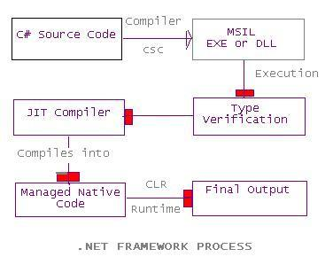
Working of c sharp
The C Sharp Compiler compiles its source code into an intermediate language .

Slide 5
Compilation of C sharp
It can be compiled with the following command line:
    csc Welcome.cs
    This produces a file named Welcome.exe, which can then be executed.

Slide 6
What is c # ?
The C# programming language (pronounced "C-Sharp") .
C Sharp is a powerful object-oriented programming languages.
Microsoft developed C#, a new programming language based on the C and C++ languages.
C# is a case sensitive language.
C# support component-oriented programming.

Slide 7
C# language features
Many of the features in C# language are preexisted in various languages such as C++, Java, Pascal, and Visual Basic.
    Object Oriented.
    Simple and Flexible.
    Automatic Memory Management.
    Cross Platform Interoperability.

Slide 8

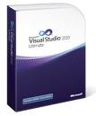
C# Editors and IDEs
      Notepad
      Visual Studio .NET

Slide 9
Application Types in C#
Class Library:- Creates a project for creating classes that can be used in other applications.
Console Application:- Creates a Visual C# application with a command-line interface.
Asp.Net Web Application:- Creates a Visual C# application with a Web user interface.
Asp.Net Web Service:- Creates an XML Web service with Visual C# that other applications can access.
Mobile Application:- Creates an application for mobile devices.

Slide 10
Programming structure
using System;
class WelcomeCSS
{
static void Main()
{
Console.WriteLine("Welcome to the C# Station Tutorial!");
}
}

Slide 11
Programming structure
The- source code for a C# program is typically stored in one text files with a file extension of .cs,
say in welcome.cs.
primary elements
  a namespace declaration.
  a class.
  a Main method.
  a program statement.
  a comments

Slide 12
Some notes to remember:
C# is case-sensitive.
The word "Main" is not the same as its lower case spelling, "main". They are different identifiers.

Slide 13
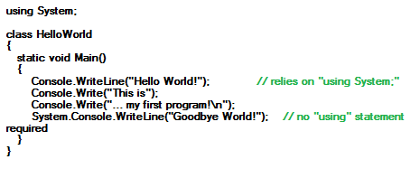
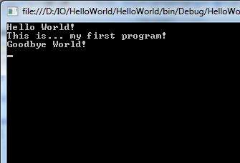
Standard Input and Output Streams
Output
  Console.WriteLine():-
    Writes the specified data, followed by the current line terminator, to the standard output stream.
The middle lines use the Write() method, which does not automatically create a new line.

Slide 14
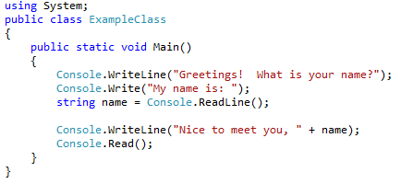
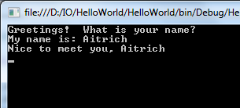
Standard Input and Output Streams
Input
  Console.ReadLine():
  Reads the next line of characters from the standard input stream.

Slide 15
Data types
C# supports mainly two kinds of types.
  value types .
  Reference types.
value types are – char, int, structures, enums .
Reference types are – class, interface, delegate, arrays.

Slide 16
Value Type
Value types reference the actual data.
A value type variable contains the data itself.
When we copy a value type variable to another one, the actual data is copied and each variable can be independently manipulated.

Slide 17
Reference types
A reference type is a reference to an instance type.
Reference type variable contains the address of memory location where data is actually stored
A null value is assigned to a reference type by default.

Slide 18
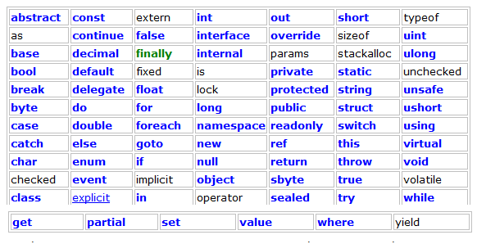
Keywords in C sharp

Slide 19
Variables
"Variables" are simply storage locations for data.
You can place data into them and retrieve their contents as part of a C# expression.
The interpretation of the data in a variable is controlled through "Types".
In C#, you declare a variable in this format:
  [modifiers] datatype identifier;

Slide 20
Variables
There are rules you must follow when naming your identifier.
  The name must start with a letter or an underscore
  After the first letter or underscore, the name can have letters, digits, and/or underscores
  The name must not have any special characters other than the underscore
  The name cannot have a space

Slide 21
Variables
You can also initialize a value during a variable declaration. For example:
  int num2 = 123;
  public static int num2 = 34;
By defining the static keyword, you can restrict a field to create only one instance of the variable of a class and share it with all other class instance of the same type.

Slide 22
Literals
Literal we mean any number, text, or other information that represents a value.
This means what you type is what you get.
For instance
  int month = 10;
  In the above statement the literal is an integer value i.e 10. The literal is 10 because it directly represents the integer value.

Slide 23
The modifiers is:
MODIFIER | DESCRIPTION
internal | The variable can only accessed by the current program.
public | The variable can be accessed from any where as a field.
protected | The variable can only be accessed with the class in which it’s defined and it’s derived class.
protected internal | The variable can only be accessed from the current program and the type derived from the current program.
private | The variable can only be accessed within the type in which it’s defined.

Slide 24
Constant
Constants are similar to read-only fields.
You can’t change a constant value once it’s assigned.
The const keyword precedes the field to define it as a constant.
  const int num3 = 34;

Slide 25

Expressions and Operators
An expression is a sequence of operators and operands that specify some sort of computation.
The operators indicate an operation to be applied to one or two operands.
Operands
Operator

Slide 26
There are three types of operators:
The unary operators take one operand and use either a prefix notation (Such as –x) or postfix notation (such as x++ ).
The binary operators take two operands and all use what is called infix notation, where the operator appears between two objects (such as x + y).
The ternary operator takes three operands and uses infix notation (such as c? x: y). Only one ternary operator, ?:, exists.

Slide 27
Control Statement- Select
Control flow and program logic are of the most important parts of a programming language.
Selection statements select one of a number of possible statements for execution based on the value of some expression.
      The if statement
      The if . . .else Statement
      The switch statement

Slide 28
Control Statement- Select
If Statement
  Syntax
  if ( boolean-expression )
  {
  embedded-statement ;
  }

Slide 29
Control Statement- Select
If/else statement
  Syntax
    if ( boolean-expression )
    {
    embedded-statement ;
    }
    else
    {
    embedded-statement ;
    }

Slide 30
Control Statement- Select
if/else if/else Statement
  Syntax
    if(Boolean-Expression)
    {
    Statement;
    }
    Else if( Boolean Expression)
    {
    Statement;
    }
    Else
    {
    Statement;
    }

Slide 31
Control Statement- Select
The switch Statement
  Switch (Boolean Expression)
    {
        Case 1: // Block of statement
        Break;
        Case 2: // Block of statement
        Break;
        Default: // Block of statement
        Break;
        }

Slide 32
Control Statement- Loop
Iteration statements repeatedly execute an embedded statement.
    while-statement
    do-statement
    for-statement
    foreach-statement

Slide 33
Control Statement- Loop
    While-statement
  The while statement conditionally executes an embedded statement zero or more times.
  while ( boolean-expression )
      {
      embedded-statement;
      }

Slide 34
Control Statement- Loop
The do statement
  This statement executes its embedded statements one or more times.
  Unlike the while Statement ,a do-while loop is executed once before the conditional expression evaluated.
  Syntax:
    do
    {
    MessageBox.Show(i.ToString());
    i++;
    }
    while (i < 3);

Slide 35
Control Statement- Loop
The for statement
  This statement begins with the for keyword and is followed by parentheses.
  The parentheses contain an initializer, a condition, and an iterator statement, all separated by semicolons.
  Syntax
  for ( for-initializer_{opt} ; for-condition_{opt} ; for-iterator_{opt} )
    {
    Statement;
    }

Slide 36
Control Statement- Loop
Example for loop
    public static void Main()
    {
    for (int i=0; i < 20; i++)
    {
    Console.Write("{0} ", i);
    }

Slide 37
Control Statement- Loop
    The foreach-statement
      The foreach statement enumerates the elements of a collection, executing an embedded statement for each element of the collection.
      foreach ( local-variable-type identifier in expression )
      {
      embedded-statement
      }

Slide 38
Control Statement- Loop
Example foreach
public static void Main()
{
string[] names = {"Cheryl", "Joe", "Matt", "Robert"};
foreach (string person in names)
{
Console.WriteLine("{0} ", person);
}
}

Slide 39

Array
An array is a data structure.
The variables contained in an array, also called the elements of the array.
The variables contained in an array all of the same type.
Array types are reference types.

Slide 40
Array
An array index starts at zero.
That means the first item of an array starts at the 0th position.
The position of the last item on an array will be total number of items - 1.
So if an array has 10 items, the last 10th item is at 9thposition.
In C#, arrays can be declared as fixed length or dynamic.
A fixed length array can store a predefined number of items.

Slide 41
Array
A dynamic array does not have a predefined size.
The size of a dynamic array increases as you add new items to the array.
Defining arrays of different types.
  double[] doubleArray = new double[5];
  char[] charArray = new char[5];
  bool[] boolArray = new bool[2];
  string[] stringArray = new string[10];

Slide 42
Array
Initializing Arrays.
  Once an array is declared, the next step is to initialize an array.
  The initialization process of an array includes adding actual data to the array.
  First:
      // Initialize a fixed array
      int[] FixedArray = new int[3] {1, 3, 5};
      // Initialize a dynamic array items during declaration
      string[] strArray = new string[] { "Mahesh Chand", "Mike Gold", "Raj Beniwal", "Praveen Kumar", "Dinesh Beniwal" };

Slide 43
Array
Accessing Arrays.
      // Initialize a fixed array one item at a time
      int[] staticIntArray = new int[3];
      staticIntArray[0] = 1;
      staticIntArray[1] = 3;
      staticIntArray[2] = 5;
      // Read array items one by one
      Console.WriteLine(staticIntArray[0]);
      Console.WriteLine(staticIntArray[1]);
      Console.WriteLine(staticIntArray[2]);

Slide 44
Array
// Initialize a dynamic array items during declaration
string[] strArray = new string[] { "Mahesh Chand", "Mike Gold", "Raj Beniwal", "Praveen Kumar", "Dinesh Beniwal" };
// Read array items using foreach loop
foreach (string str_var in strArray)
{
Console.WriteLine(str_var);
}

Slide 45
Array Types
Arrays can be divided into the following four categories.
  Single-dimensional arrays
  Multidimensional arrays or rectangular arrays
  Jagged arrays

Slide 46
Single Dimension Arrays
All items in a single dimension array are stored contiguously starting from 0 to the size of the array -1.
  int[] intArray;
  intArray = new int[3];

Slide 47
Array
Second
      // Initialize a fixed array one item at a time
      int[] staticIntArray = new int[3];
      staticIntArray[0] = 1;
      staticIntArray[1] = 3;
      staticIntArray[2] = 5;

Slide 48
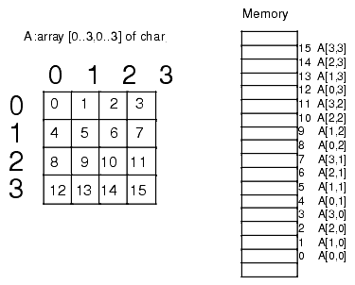
Multi-Dimensional Arrays
A multi-dimensional array, also known as a rectangular array is an array with more than one dimension.
The form of a multi-dimensional array is a matrix.
  Declaring a multi-dimensional array
  string[,] mutliDimStringArray;
  A multi-dimensional array can be fixed-sized or dynamic sized.
  String[2,2] mutliDimStringArray2;

Slide 49
Multi-Dimensional Arrays
Initializing multi-dimensional arrays
  int[,] numbers = new int[3, 2] { { 1, 2 }, { 3, 4 }, { 5, 6 } };
  string[,] names = new string[2, 2] { { "Rosy", "Amy" }, { "Peter", "Albert" } };
You can also omit the new operator as we did in single dimension arrays. You can assign these values directly without using the new operator.
  int[,] numbers = { { 1, 2 }, { 3, 4 }, { 5, 6 } };
  string[,] names = { { "Rosy", "Amy" }, { "Peter", "Albert" } };

Slide 50
Multi-dimensional arrays
Accessing multi-dimensional arrays
  we need to specify the matrix dimension
  For example, item(1,2) represents an array item in the matrix at second row and third column.
  Console.WriteLine(numbers[0,0]);
  Console.WriteLine(numbers[0, 1]);
  Console.WriteLine(numbers[1, 0]);
  Console.WriteLine(numbers[1, 1]);
  Console.WriteLine(numbers[2, 0]);
  Console.WriteLine(numbers[2, 2]);

Slide 51
Jagged Arrays
Jagged arrays are arrays of arrays.
A jagged array is an array whose elements are arrays.
A jagged array is sometimes called an "array of arrays."
Declaration of a jagged array involves two brackets.
For example:
  int[][] JaggedArray = new int[3][];
  a jagged array that has three items of an array.
Jagged array that has two items of an array.
  string[][] stringJaggedArray = new string[2][];

Slide 52
Jagged Arrays
Initializing Jagged Arrays
  Before a jagged array can be used, its items must be initialized.
  The following code snippet initializes a jagged array;
      // Initializing jagged arrays
      JaggedArray[0] = new int[2];
      JaggedArray[1] = new int[4];
      JaggedArray[2] = new int[6];

Slide 53
Jagged Arrays
We can also initialize a jagged array's items by providing the values of the array's items.
  // Initializing jagged arrays
  JaggedArray[0] = new int[2]{2, 12};
  JaggedArray[1] = new int[4]{4, 14, 24, 34};
  JaggedArray[2] = new int[6] {6, 16, 26, 36, 46, 56 };

Slide 54
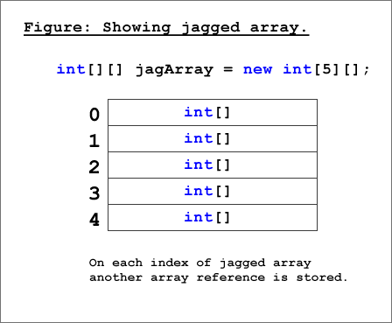
Accessing Jagged Arrays
We can access a jagged array's items individually in the following way:
  Console.Write(JaggedArray[0][0]);
  Console.WriteLine(JaggedArray[2][5]);

Slide 55
Accessing Jagged Arrays
We can also loop through all of the items of a jagged array.
Loop through all items of a jagged array.
  for (int i = 0; i < JaggedArray.Length; i++)
  {
  System.Console.Write("Element({0}): ", i);
  for (int j = 0; j < intJaggedArray[i].Length; j++)
  {
  System.Console.Write("{0}{1}",intJaggedArray[i][j],j ==(intJaggedArray[i].Length - 1) ? "" : " ");
  }
  System.Console.WriteLine();
  }

Slide 56
Enums
An enum type is a distinct value type with a set of named constants.
The enum keyword is used to declare an enumeration.
Enums are strongly typed constants.
All member of enum are of enum type.
Enums type can be integer (float, int, byte, double etc.).
The default underlying type of the enumeration element is int.

Slide 57
Enums
By default, the first enumerator has the value 0, and the value of each successive enumerator is increased by 1.
Enumerations (enums) make your code much more readable and understandable.
Every enum type automatically derives from System.Enum
Syntax
  An enum is declared as follows:
  [modifiers] enum identifier
  {
  enumerator-list [,]
  }

Slide 58
Enums
The attributes is optional and is used to hold additional declarative information.
Modifiers are new, public, protected, internal and private.
The keyword enum must be followed by an identifier that names the enum.
The underlying type that specifies the storage allocated for each enumerator. It can be one of the integral types except char. The default is int..
The enumerator-list contains the identifiers which are separated by commas

Slide 59
Enums
Example:
  enum Dow {Sat, Sun, Mon, Tue, Wed, Thu, Fri};
You can Assign value :
  enum Dow {Sat=7, Sun=0, Mon=1, Tue=3, Wed=4, Thu=7, Fri=8};

Slide 60
Type Conversions
Type conversion is converting one type of data to another type. It is also known as Type Casting.
In C# Type casting has two forms
1. Implicit type conversion
2. Explicit type conversion
Implicit type conversion:- conversions from smaller to larger integral types
1:int ctr = 999;
2:long count = ctr;
// implicit conversion from int type to long type

Slide 61
Type Conversions
Explicit type conversion:- These conversions are done explicitly by users using the pre-defined functions.
1:long count = 999;
2:int cnt = (int)count;
// explicit conversion from long type to int type

Slide 62
Nullables
A value type cannot be assigned a null value. For example, int i = null will give you a compile time error.
Introduced Nullable Types that allow you to assign null to value type variables.
Syntax
< data_type> ? <variable_name> = null;

Slide 63
Structures
A structure is a value type data type. It helps you to make a single variable hold related data of various data types. The struct keyword is used for creating
a structure.
Structures are used to represent a record.
For example, declare the Book structure
struct Books {
public string title;
public string author;
public int book_id;
};

Slide 64
Namespaces
A namespace is designed for providing a way to keep one set of names separate from another. The class names declared in one namespace does not conflict with the same class names declared in another.
Defining a Namespace
namespace namespace_name
{
// code declarations
}

Slide 65
Regular Expressions
Regular expressions are a pattern matching standard for string parsing and replacement and is a way for a computer user to express how a computer program should look for a specified pattern in text and then what the program is to do when each pattern match is found.

Slide 66
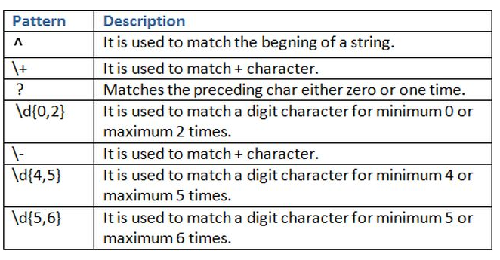
Regular Expressions
Regular Expression Pattern

Slide 67

Summary
C# is an international standard programming language used to create instructions that direct the computer about what to do, when to do it, and how to do something.
Understand the basic structure of a C# program.
Basic familiarization of what a "Namespace" is.
Understand what a variable is.
Get an introduction to C# operators.
Learn how to use Arrays.
Learn the if statements.
Learn the switch statement.
Learn the while loop.
Learn the do loop.
Learn the for loop.
Learn the foreach loop.

Slide 68

QUESTIONS

Slide 69


